Slide 1
LANDMINE DETECTION ROBOTIC VEHICLE
AAKASH.A-20BEC1294
KAVIN KRISHNA.K.P-20BEC1121
HARINARAYANAN.M-20BEC1156

Slide 2
ABSTRACT:
Landmines are explosive devices which are typically concealed under the ground and usually triggered using pressure, thus detonating whenever a target steps over or drives over it.
Demining refers to the process of removing landmines from an area to make sure safe for civilian usage
This vehicle uses a metal sensing coil to detect mines hidden under the surface of the earth and it is capable of finding buried mines, noting their precise location, and stopping itself from stepping on them.
The detector coil has electricity flowing through it that creates a magnetic field around the coil which is detected by the detector. This signal is picked up by the ESP 32 controller. The controller now uses itsintegrated WIFI module to transmit the GPS coordinates to a us via messaging or mobile application. Thus, it allows a user to get GPS location data of all landmines in an area using this autonomous mine detector robotic vehicle.

Slide 3
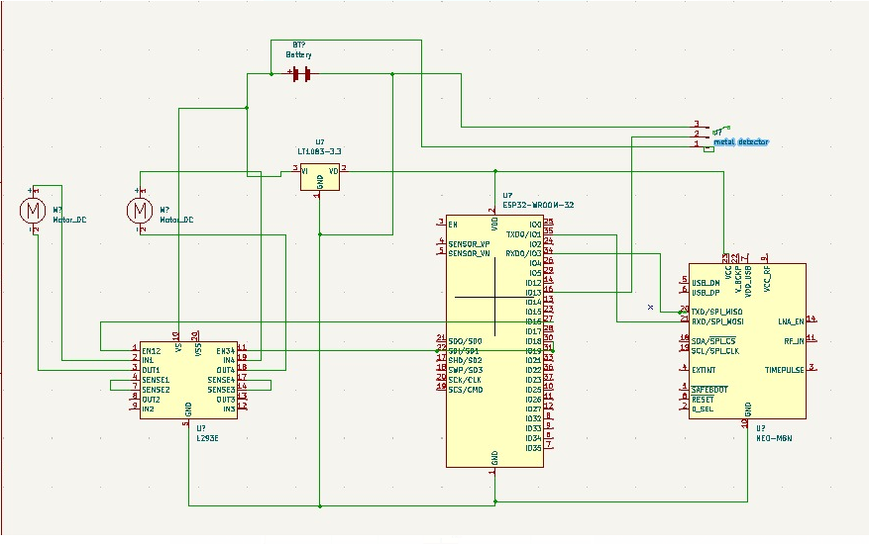
CIRCUIT DIAGRAM:

Slide 4
COMPONENTS:
esp32 wroom 32
A88 metal detector
9v battery
Bomotor
L293d
Dotboard
Wires
volatge regulatro3.3v
gps neo6m

Slide 5
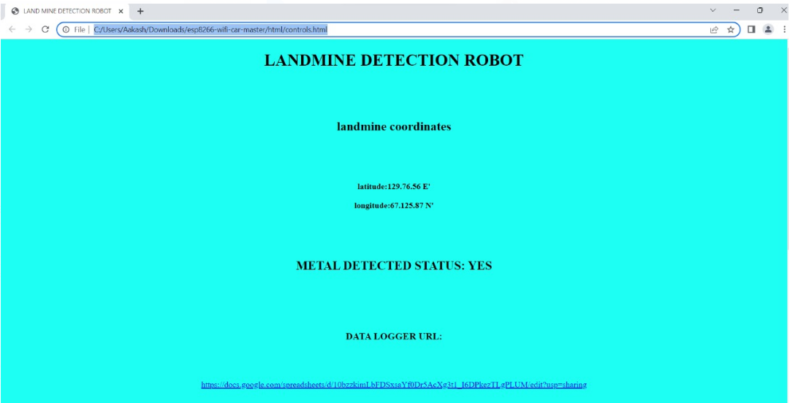
SOME RESULTS OF OUR WORK:
WEB CONTROLLER

Slide 6
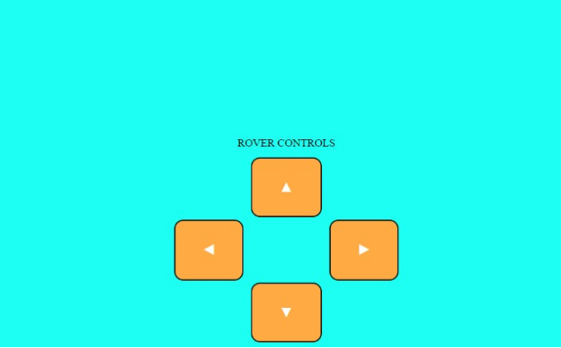
ROVER CONTROL

Slide 7

WEB SERVER

Slide 8
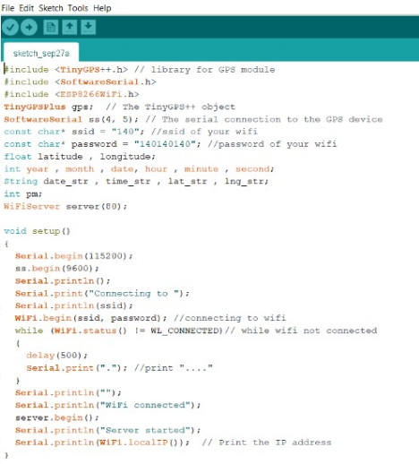
CODE USED

Slide 9
REFERENCES:
E. Abbott, D. Powell, “Land-Vehicle Navigation Using GPS,” Proceedings of IEEE, Vol.87, No.1, 1999
H. Aoyama, K. Ishikawa, J. Seki, M. Okamura,S. Ishimura, Y. Satsumi, “Development of Mine Detection Robot System”, International Journal of Advanced Robotic Systems, ISSN: 1729-8806, 2008
M.K. Habib, "Mine detection and sensing technologies-new development potentials in the context of humanitarian demining", Industrial Electronics Society.
Zhenjun. He, Jiang. Zhang, Peng. Xu, Jiaheng. Qin and Yunkai. Zhu, Mine detecting robot based on wireless communication with multi-sensor.

